Slide 1

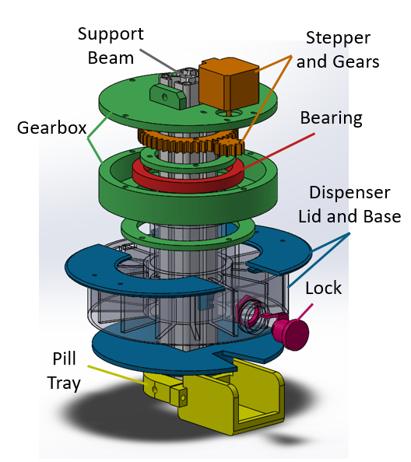
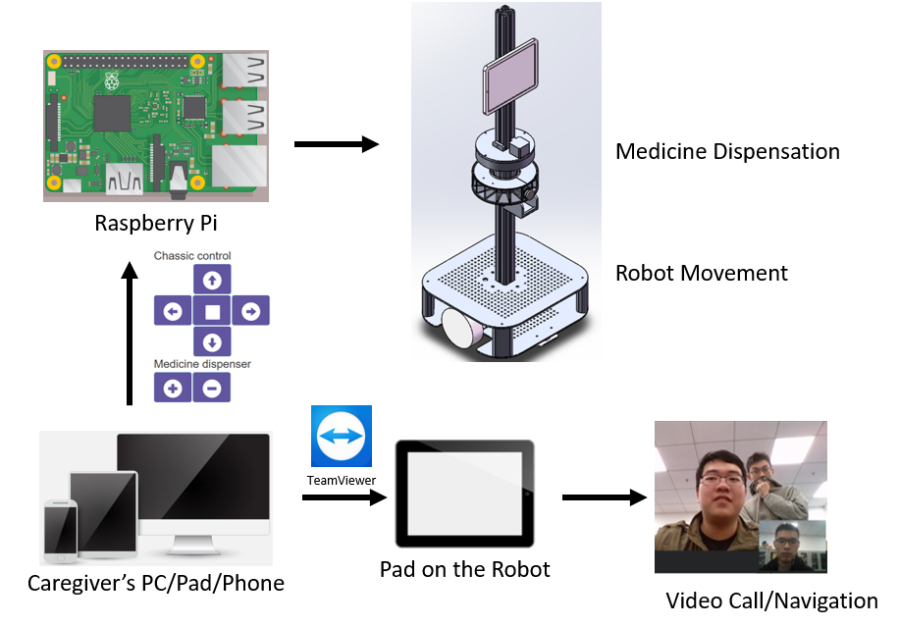
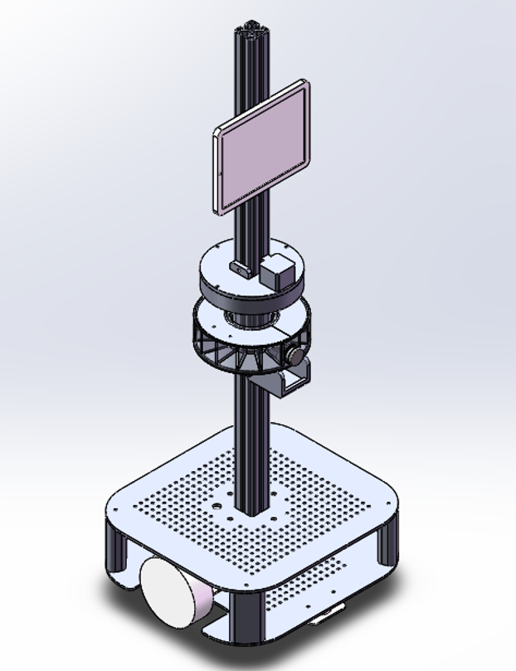
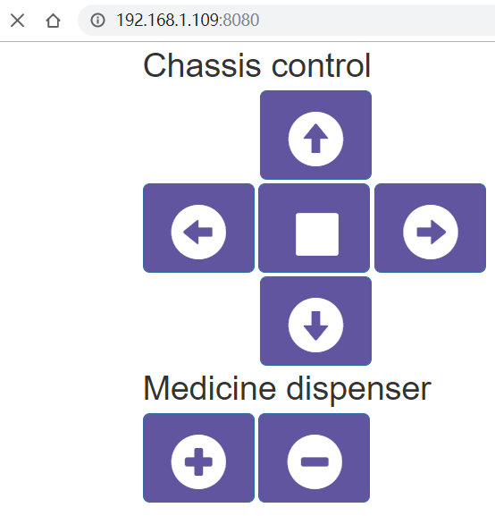
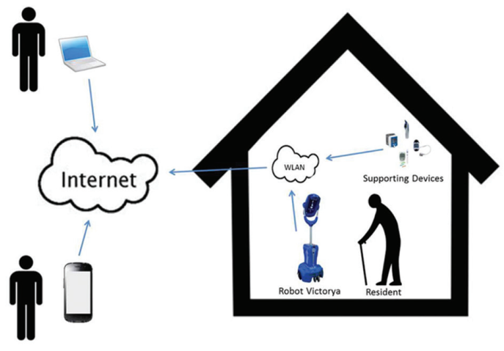
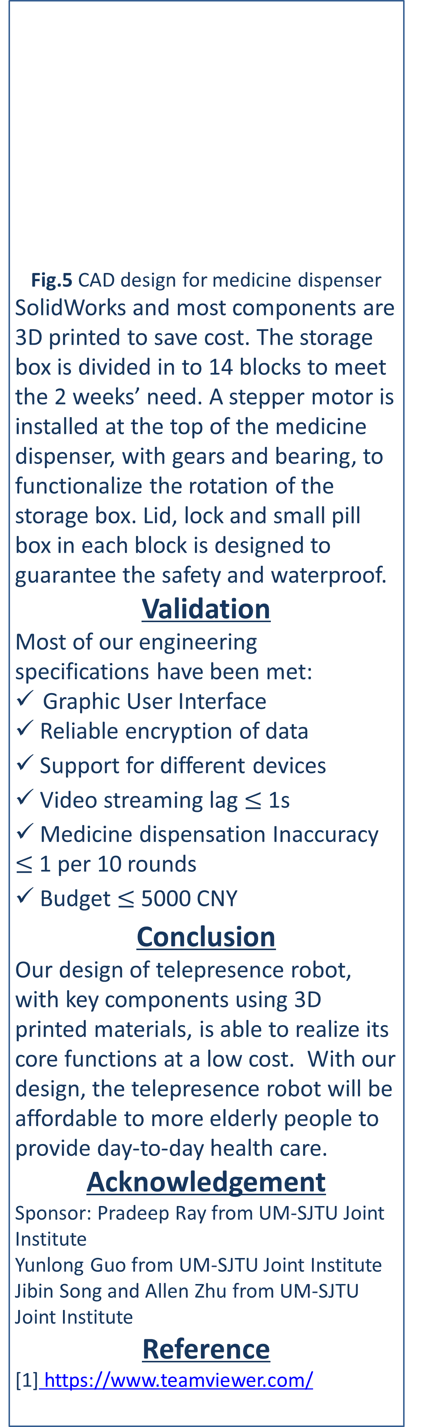
VM450 • Design and Manufacturing III
& VE450 • Major Design Experience
Healthcare Telepresence Robot for the Elderly
Sponsor: Pradeep Ray UM-SJTU JI CFE
Team Members: Chongdan Pan, Fernando Boaro, Niyiqiu Liu, Ruixing Zhou, Tianyu Qiu
Faculty Advisor: Prof. Pradeep Ray Instructor: Prof. Yunlong Guo
Problem Statement
To maintain independent lifestyles, many elderly people prefer to live at home alone rather than in nursing homes. However, family members often worry about the well-being of their elderly relatives and feel unsafe to leaving them unsupervised at home. Additionally, due to the geographical distances, family members are often unable to visit relatives frequently, leading to a loss of bond with family that in turn leads to frustration and loneliness amongst the elderly. Our project is a cheap robot for caregivers to provide physical and mental care for the elderly when they’re far away from each other.
Fig. 1 Overview for the robot
Concept Generation
The robot serves as a substitute for the caregiver when he or she is far away. It can be controlled remotely by caregivers through computers or mobile devices. Medicine dispensation is one key feature of
the robot, which can give old people
medicines when they’re inconvenient
or forget to take it. Also, the robot has
Fig. 2 Concept diagram for the robot
a screen and a camera for video call, which can also be used for navigation when caregivers is driving it remotely.
Remote Control
Fig.3 Remote control flow diagram
The control flow of our robot is shown in Fig. 3. We use Raspberry Pi as the central processing unit for the robot, which can control the medicine dispenser and the chassis by output voltage signal to the driving motor and servo. To realize remote control, a software called TeamViewer [1] is used by us to build communication between controller and the Raspberry Pi. With its help, the caregivers can log into the Raspberry Pi or the screen as long as they are connected to the Internet.
Graphic User Interface
To make the user interface simple and accessible from all devices, we implemented a web-based controller for the robot. The website in shown in Fig. 4. Once boot up, the Raspberry Pi would run the control program that
listens to inputs from the web page. The user may enter the IP address of
the Raspberry Pi to visit the web page.
Fig. 4 Screen shot of the web page
Medicine Dispenser
The medicine dispenser is designed in
Fig.5 CAD design for medicine dispenser
SolidWorks and most components are 3D printed to save cost. The storage box is divided in to 14 blocks to meet the 2 weeks’ need. A stepper motor is installed at the top of the medicine dispenser, with gears and bearing, to functionalize the rotation of the storage box. Lid, lock and small pill box in each block is designed to guarantee the safety and waterproof.
Validation
Most of our engineering specifications have been met:
Graphic User Interface
Reliable encryption of data
Support for different devices
Video streaming lag $≤$ 1s
Medicine dispensation Inaccuracy $≤$ 1 per 10 rounds
Budget $≤$ 5000 CNY
Conclusion
Our design of telepresence robot, with key components using 3D printed materials, is able to realize its core functions at a low cost. With our design, the telepresence robot will be affordable to more elderly people to provide day-to-day health care.
Acknowledgement
Sponsor: Pradeep Ray from UM-SJTU Joint Institute
Yunlong Guo from UM-SJTU Joint Institute
Jibin Song and Allen Zhu from UM-SJTU Joint Institute
Reference
[1] https://www.teamviewer.com/

